Slide 1






nRc-cnRc:
R Learning Group
Women in Science & Innovation
June 15th, 2023
Reiko Okamoto
Solenn Mordret
Jenna MacKinnon

Slide 2



Agenda
Housekeeping Details
Schedule
Topics to Discover
Resources and links
Github
R & R studio Layout
Start coding!

Slide 3



Housekeeping Details
R Learning group schedule and format Github Virtual and recorded | Sessions will be in English, but please ask questions using the chat function (or email us) in French or English Consult your supervisor before using R & RStudio if you are using it for a client project or for product/package development

Slide 4

Schedule
(Every second Thursday covering 4 sessions, starting June 15th)
Introduction to R &RStudio: June 15th
Introduction to Data Visualization (Part I): June 29th
Introduction to Data Visualization (Part II): July 13th
Introduction to Data Wrangling: July 27th
(Potentially more sessions to come!)

Slide 5

Topics to Discover
These general topics (and more!) will be covered throughout a series of virtual code-a-long sessions
Introduction to R & RStudio | Data Visualization | Data Wrangling
R vocabulary Creating clear, organized scripts Using Github repositories for sharing scripts Creating a project Importing data Troubleshooting | Packages: ggplot2 Scatterplots, Line plots, bar plots Aesthetics & Colours Heatmaps Trees | Packages: tidyverse (plyr, dplyr) filter(), select(), mutate(), arrange(), summarise() Transforming/preparing data into structured format Data cleaning, integration, reshaping, validation
Potential Future Topics:
Classical statistics, machine learning, mapping, image analysis, predictive modelling, etc.
Notes:
R vocab – working directory, project, script, difference between R and Rstudio

Slide 6
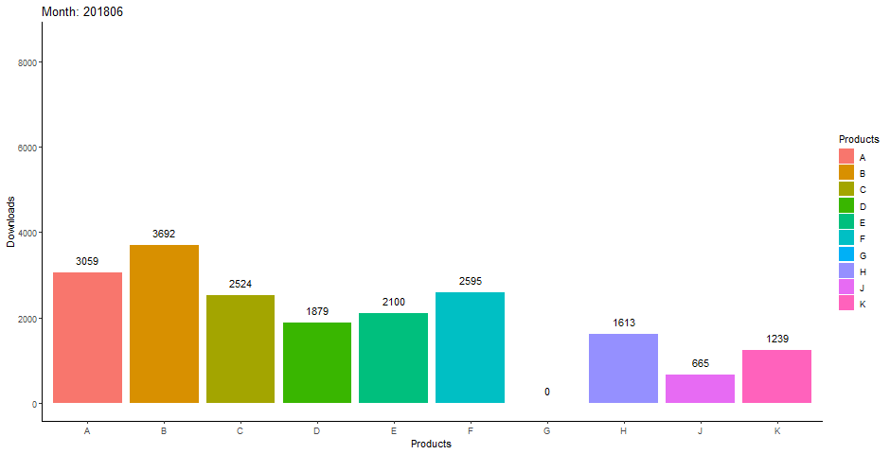
Notes:
- Add citation

Slide 7
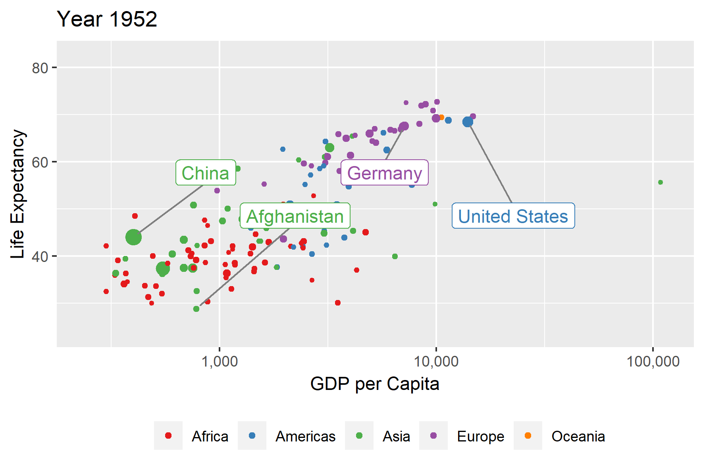
Notes:
- Add citation

Slide 8




If you want us to cover concepts related to your specific dataset in future sessions, send us a detailed description of your data and we can try to work through analyses together using R!

Slide 9


Graphics & Colours
https://r-graph-gallery.com/
HTML Color Picker (w3schools.com)
HTML Color Codes Chart (rapidtables.com)
Slide 1 (ucsb.edu)
From data to Viz | Find the graphic you need (data-to-viz.com) https://www.data-to-viz.com/
asteves/tayloRswift: For when your colors absolutely should not be excluded from the narrative. (github.com)
Introduction to R
https://cran.r-project.org/
https://datacarpentry.org/R-genomics/01-intro-to-R.html
http://www.cookbook-r.com/
Tidyverse
R-Ladies Vancouver (Eng) - Programming with Tidyverse functions - Dr Tiffany Timbers - YouTube
R Cheatsheets
https://www.rstudio.com/resources/cheatsheets/
Helpful Resources and Links

Slide 10

Do you have any questions?
Send it to us in French or English!
Jenna.mackinnon@nrc.ca
Solenn.Mordret@nrc.ca
Reiko.Okamoto@nrc.ca

Slide 11
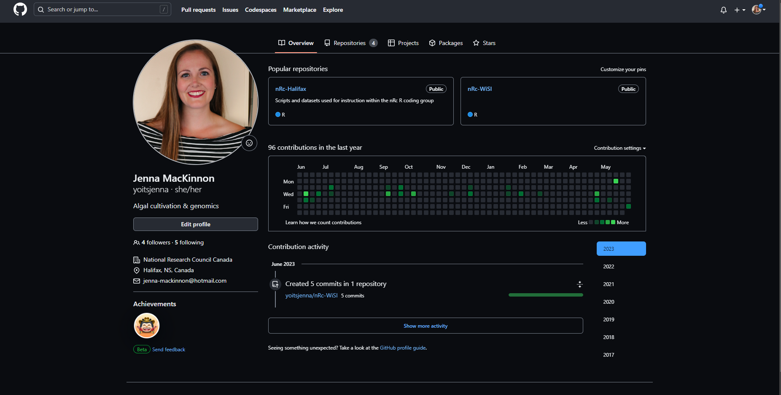
https://github.com/
yoitsjenna (Jenna MacKinnon) (github.com)
reikookamoto (Reiko Okamoto) (github.com)
Notes:
Add reiko and jenna
Set up masterbranch request

Slide 12
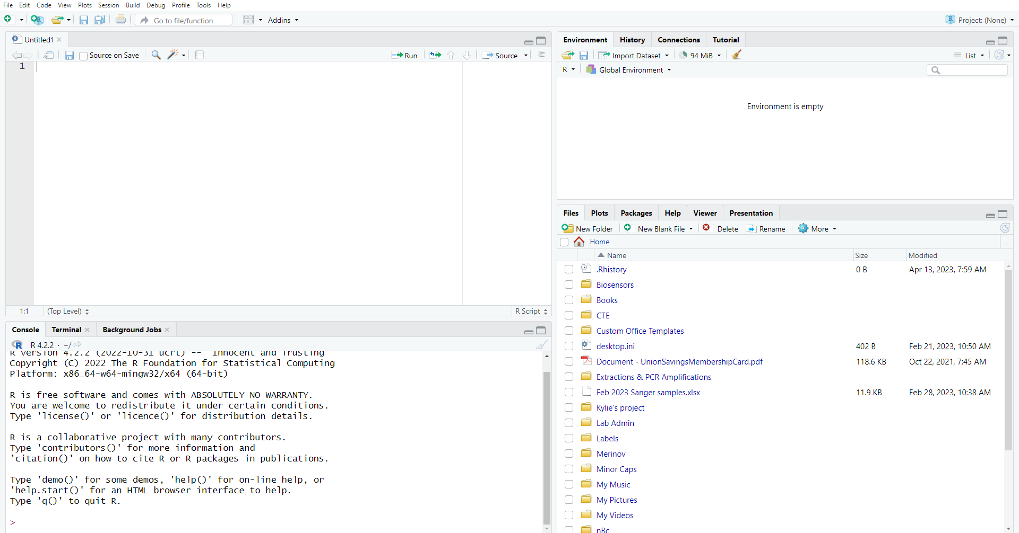
ENVIRONMENT
Current objects and data
SOURCE
Able to save and edit scripts continually
HISTORY
Log of previously-run code
PLOTS
Shows all output plots here
CONSOLE
Shows code output and can be used for coding that will NOT be saved
PACKAGES
HELP

